Slide 1
COEN 275 Object-Oriented Analysis, Design and Programming (4 units)
Paddu Melanahalli
pmelanahalli@scu.edu
School of Engineering/Graduate Engineering

Slide 2
Value 1: Individuals and Interactions over Processes and Tools
Strong players: a must, but can fail if don’t work together.
Strong player: not necessarily an ‘ace;’ work well with others!
Communication and interacting is more important than raw talent.
‘Right’ tools are vital to smooth functioning of a team.
Start small. Find a free tool and use until you can demo you’ve outgrown it. Don’t assume bigger is better. Start with white board; flat files before going to a huge database.
Building a team more important than building environment.
Some managers build the environment and expect the team to fall together.
Doesn’t work.
Let the team build the environment on the basis of need.

Slide 3
Value 2: Working Software over Comprehensive Documentation
Code – not ideal medium for communicating rationale and system structure.
Team needs to produce human readable documents describing system and design decision rationale.
Too much documentation is worse than too little.
Take time; more to keep in sync with code; Not kept in sync? it is a lie and misleading.
Short rationale and structure document.
Keep this in sync; Only highest level structure in the system kept.

Slide 4
Value 2: Working Software over Comprehensive Documentation
How to train newbees if short & sweet?
Work closely with them.
Transfer knowledge by sitting with them; make part of team via close training and interaction
Two essentials for transferring info to new team members:
Code is the only unambiguous source of information.
Team holds every-changing roadmap of systems in their heads; cannot put on paper.
Best way to transfer info- interact with them.
Fatal flaw: Pursue documentation instead of software:
Rule: Produce no document unless need is immediate and significant.

Slide 5
Value 3: Customer Collaboration over Contract Negotiation (1 of 2)
Not possible to describe software requirements up front and leave someone else to develop it within cost and on time.
Customers cannot just cite needs and go away
Successful projects require customer feedback on a regular and frequent basis – and not dependent upon a contract or SOW.

Slide 6
Value 3: Customer Collaboration over Contract Negotiation (2 of 2)
Best contracts are NOT those specifying requirements, schedule and cost.
Become meaningless shortly.
Far better are contracts that govern the way the development team and customer will work together.
Key is intense collaboration with customer and a contract that governed collaboration rather than details of scope and schedule
Details ideally not specified in contract.
Rather contracts could pay when a block passed customer’s acceptance tests.
With frequent deliverables and feedback, acceptance tests never an issue.

Slide 7
Value 4: Responding to Change over Following a Plan
Better planning strategy – make detailed plans for the next few weeks, very rough plans for the next few months, and extremely crude plans beyond that.
Need to know what we will be working on the next few weeks; roughly for the next few months; a vague idea what system will do after a year.
Only invest in a detailed plan for immediate tasks; once plan is made, difficult to change due to momentum and commitment.
But rest of plan remains flexible. The lower resolution parts of the plan can be changed with relative ease.

Slide 8
Principle 1: Our Highest Priority is to Satisfy the Customer through Early and Continuous Delivery of Valuable Software
Number of practices have significant impact upon quality of final system:
1. Strong correlation between quality and early delivery of a partially functioning system.
The less functional the initial delivery, the higher the quality of the final delivery.
2. Another strong correlation exists between final quality and frequently deliveries of increasing functionality.
The more frequent the deliveries, the higher the final quality.
Agile processes deliver early and often.
Rudimentary system first followed by systems of increasing functionality every few weeks.
Customers my use these systems in production, or
May choose to review existing functionality and report on changes to be made.
Regardless, they must provide meaningful feedback.

Slide 9
Principle 2: Welcome Changing Requirements, even late in Development. Agile Processes harness change for the Customer’s Competitive Advantage.
This is a statement of attitude.
Participants in an agile process are not afraid of change.
Requirement changes are good;
Mean team has learned more about what it will take to satisfy the market.
Agile teams work to keep the software structure flexible, so requirement change impact is minimal.
More so, the principles of object oriented design help us to maintain this kind of flexibility.

Slide 10
Principle 3: Deliver Working Software Frequently (From a couple of weeks to a couple of months with a preference to the shorter time scale.
We deliver working software.
Deliver early and often.
Be not content with delivering bundles of documents, or plans.
Don’t count those as true deliverables.
The goal of delivering software that satisfies the customer’s needs.

Slide 11
Principle 4: Business People and Developers Must Work Together Daily throughout the Project.
For agile projects, there must be significant and frequent interaction between the
customers,
developers, and
stakeholders.
An agile project must be continuously guided.

Slide 12
Principle 5: Build Projects around Motivated Individuals. (Give them the environment and support they need, and trust them to get the job done.)
An agile project has people the most important factor of success.
All other factors, process, environment, management, etc., are considered to be second order effects, and are subject to change if they are having an adverse effect upon the people.
Example: if the office environment is an obstacle to the team, change the office environment.
If certain process steps are obstacles to the team, change the process steps.

Slide 13
Principle 6: The Most Efficient and Effective Method of Conveying Information to and within a Development Team is face-to-face Communications.
In agile projects, developers talk to each other.
The primary mode of communication is conversation.
Documents may be created, but there is no attempt to capture all project information in writing.
An agile project team does not demand written specs, written plans, or written designs.
They may create them if they perceive an immediate and significant need, but they are not the default.
The default is conversation.

Slide 14
Principle 7: Working Software is the Primary Measure of Progress
Agile projects measure their progress by measuring the amount of working software.
Progress not measured by phase we are in, or
by the volume of produced documentation or
by the amount of code they have created.
Agile teams are 30% done when 30% of the necessary functionality is working.

Slide 15
Principle 8: Agile Processes promote sustainable development The sponsors, developers, and users should be able to maintain a constant pace indefinitely.
An agile project is not run like a 50 yard dash; it is run like a marathon.
The team does not take off at full speed and try to maintain that speed for the duration.
Rather they run at a fast, but sustainable, pace.
Running too fast leads to burnout, shortcuts, and debacle.
Agile teams pace themselves.
They don’t allow themselves to get too tired.
They don’t borrow tomorrow’s energy to get a bit more done today.
They work at a rate that allows them to maintain the highest quality standards for the duration of the project.

Slide 16
Principle 9: Continuous Attention to Technical Excellence and Good Design enhances Agility.
High quality is the key to high speed.
The way to go fast is to keep the software as clean and robust as possible.
Thus, all agile team-members are committed to producing only the highest quality code they can.
They do not make messes and then tell themselves they’ll clean it up when they have more time.
Do it right the first time!

Slide 17
Principle 10: Simplicity – the art of maximizing the amount of work not done – is essential.
Agile teams take the simplest path that is consistent with their goals.
They don’t anticipate tomorrow’s problems and try to defend against them today.
Rather they do the simplest and highest quality work today, confident that it will be easy to change if and when tomorrows problems arise.

Slide 18
Principle 11: The Best Architectures, Requirements, and Designs emerge from Self-Organizing Teams
An agile team is a self organizing team.
Responsibilities are not handed to individual team members from the outside.
Responsibilities are communicated to the team as a whole, and the team determines the best way to fulfill them.
Agile team members work together on all project aspects.
Each is allowed input into the whole.
No single team member is responsible for the architecture, or the requirements, or the tests, etc.
The team shares those responsibilities and each team member has influence over them.

Slide 19
Principle 12: At regular Intervals, the Team reflects on how to become more effective, then tunes and adjusts its behavior accordingly.
An agile team continually adjusts its organization, rules, conventions, relationships, etc.
An agile team knows that its environment is continuously changing, and knows that they must change with that environment to remain agile.

Slide 20
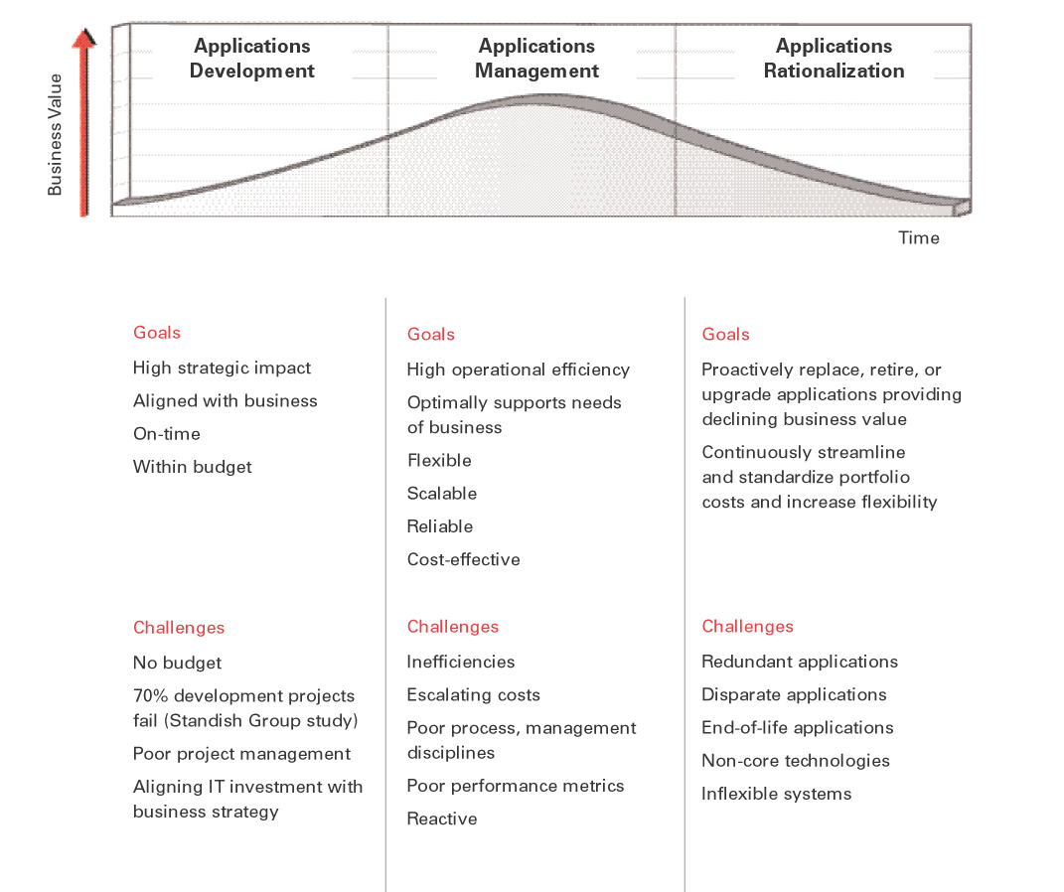
Software release process
Release Management (aka Release Train) can be defined as a methodology - planning and implementing an integrated set of functional components and processes in a systematic manner.
Date driven releases are scoped in order to meet pre-specified delivery dates, the project management “Iron Triangle” balanced on the schedule apex.
Reversed planned start with your target implementation dates and work backwards.
Mechanized process should try to emulate a typical factory operation.
Forecasted schedules as well as functionality; force an organization to strategize and plan in advance.
Integrated and predictable; many business needs folded into one release, and everyone knows the schedule.
Uses standard system development lifecycle (SDLC) and project management methodologies (PMBOK) and best practices

Slide 21
Release Strategy
What are the systems? Is there a grouping of systems?
How many releases?
Time based
Content based
When to release?
How much overlap?
Q1 04
Q2 04
Q3 04
Q4 04
Q1 05
J
F
M
A
M
J
J
A
S
O
N
D
J
F
M
Release 1
Release 2
Release 3
Release 4

Slide 22
Release Timeline
Q1
Q2
Q3
Q4
Q1
J
F
M
A
M
J
J
A
S
O
N
D
J
F
M
Project 1a (OPS)
Project 2 (Strategy)
Unknown (5%)
Project 1b (OPS)
Project 3 (Engineering)
Project 5 (OPS)
Unknown (10%)
Project 1c (OPS)
Project 6 (Engineering)
Unknown (25%)
Release Package 1
15-Aug-05
Release Package 2
15-Dec-05
Release Package 3
15-Apr-06
Q1
Q2
Q3
Q4
Q1
J
F
M
A
M
J
J
A
S
O
N
D
J
F
M
Requirements
Freeze
Scope
Freeze
Development
Testing
Deploy
Requirements
Freeze
Scope
Freeze
Development
Testing
Deploy
Requirements
Freeze
Scope
Freeze
Development
Testing
Deploy

Slide 23
Quality Management
The focus may be ‘fitness for purpose’ rather than specification conformance.
Have programming and documentation standards been followed in the development process?
Has the software been properly tested?
Is the software sufficiently dependable to be put into use?
Is the performance of the software acceptable for normal use?
Is the software usable?
Is the software well-structured and understandable?
Quality management provides an independent check on the software development process.
The quality management process checks the project deliverables to ensure that they are consistent with organizational standards and goals
The quality team should be independent from the development team so that they can take an objective view of the software. This allows them to report on software quality without being influenced by software development issues.
Quality management is particularly important for large, complex systems. The quality documentation is a record of progress and supports continuity of development as the development team changes.
For smaller systems, quality management needs less documentation and should focus on establishing a quality culture.

Slide 24
Software Quality
Quality assurance
The development of a framework of organizational procedures and standards that lead to high quality software.
Quality planning
The selection of appropriate procedures and standards from this framework and adapt for a specific software project.
Quality control
Definition of processes ensuring that software development follows the quality procedures and standards.
Software Quality Attributes
Safety
Security
Reliability
Resilience
Robustness
Understandability
Testability
Adaptability
Modularity
Complexity
Portability
Usability
Accessibility
Reusability
Efficiency
Learnability

Slide 25
Thank You!

